Slide 1
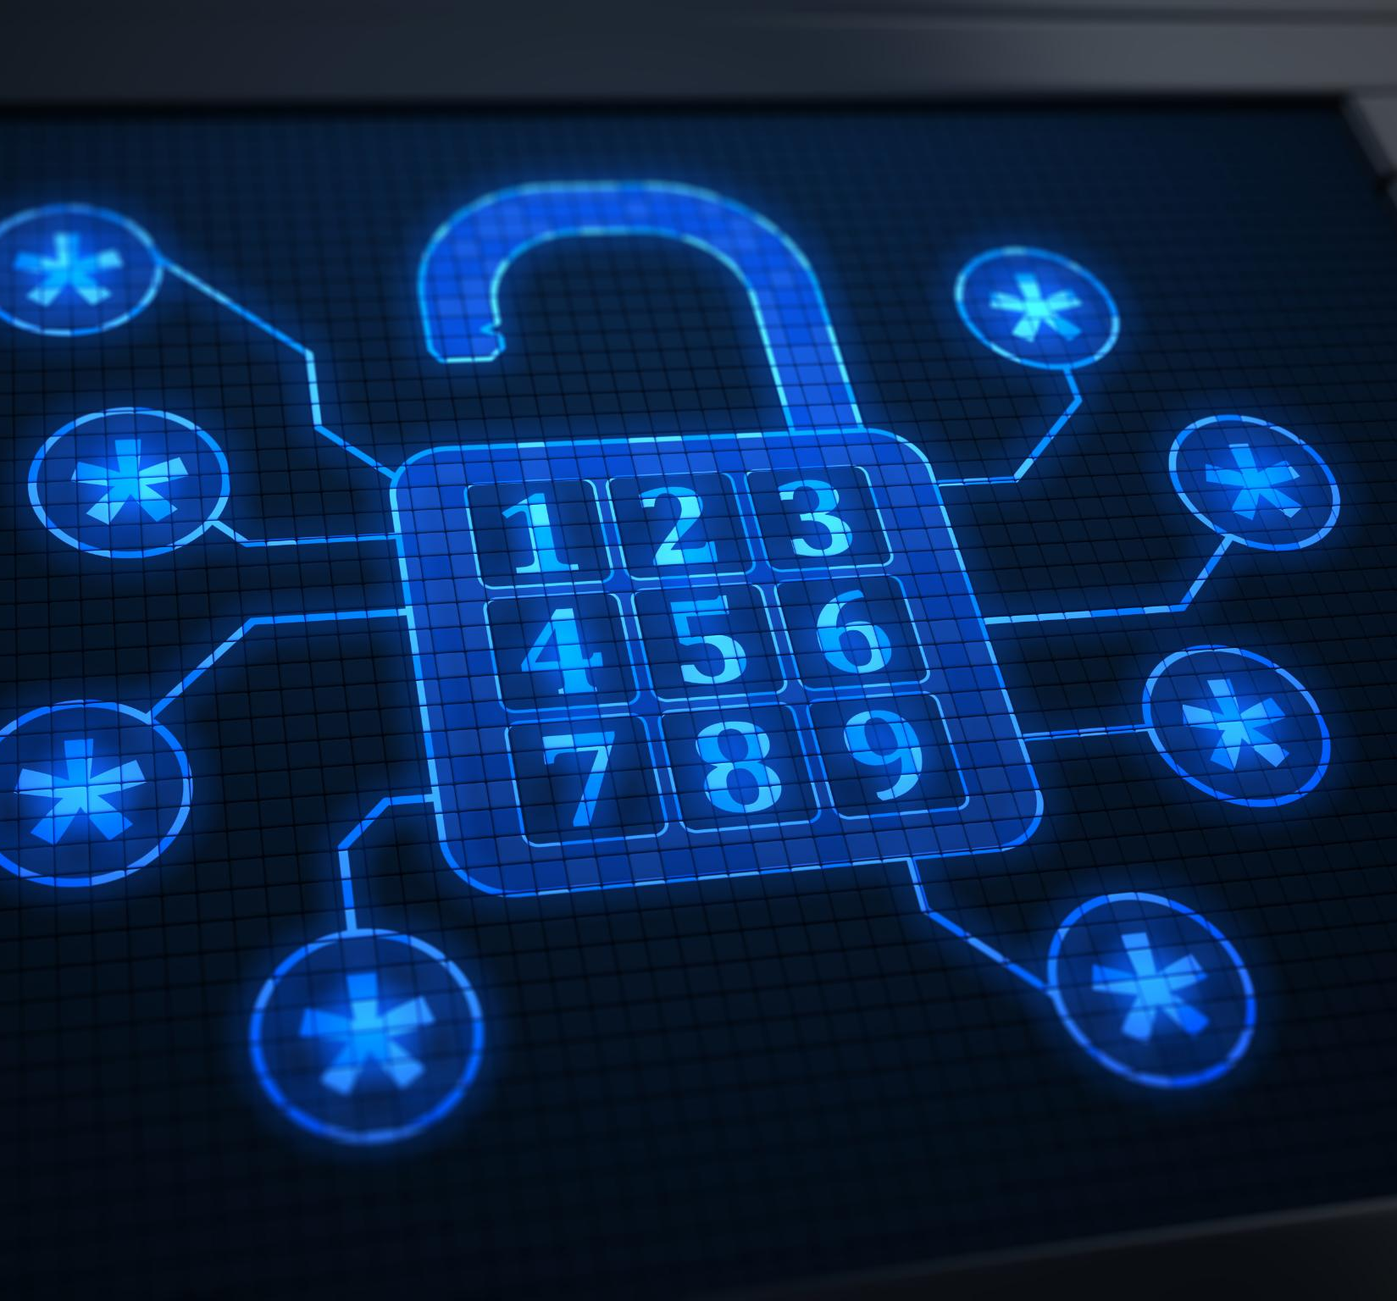
Cybersecurity Awareness: Password Hygiene and Multi-Factor Authentication (MFA)
Enhancing security through strong passwords and verification
Presented By: Arr Domingo
Notes:
---

Slide 2
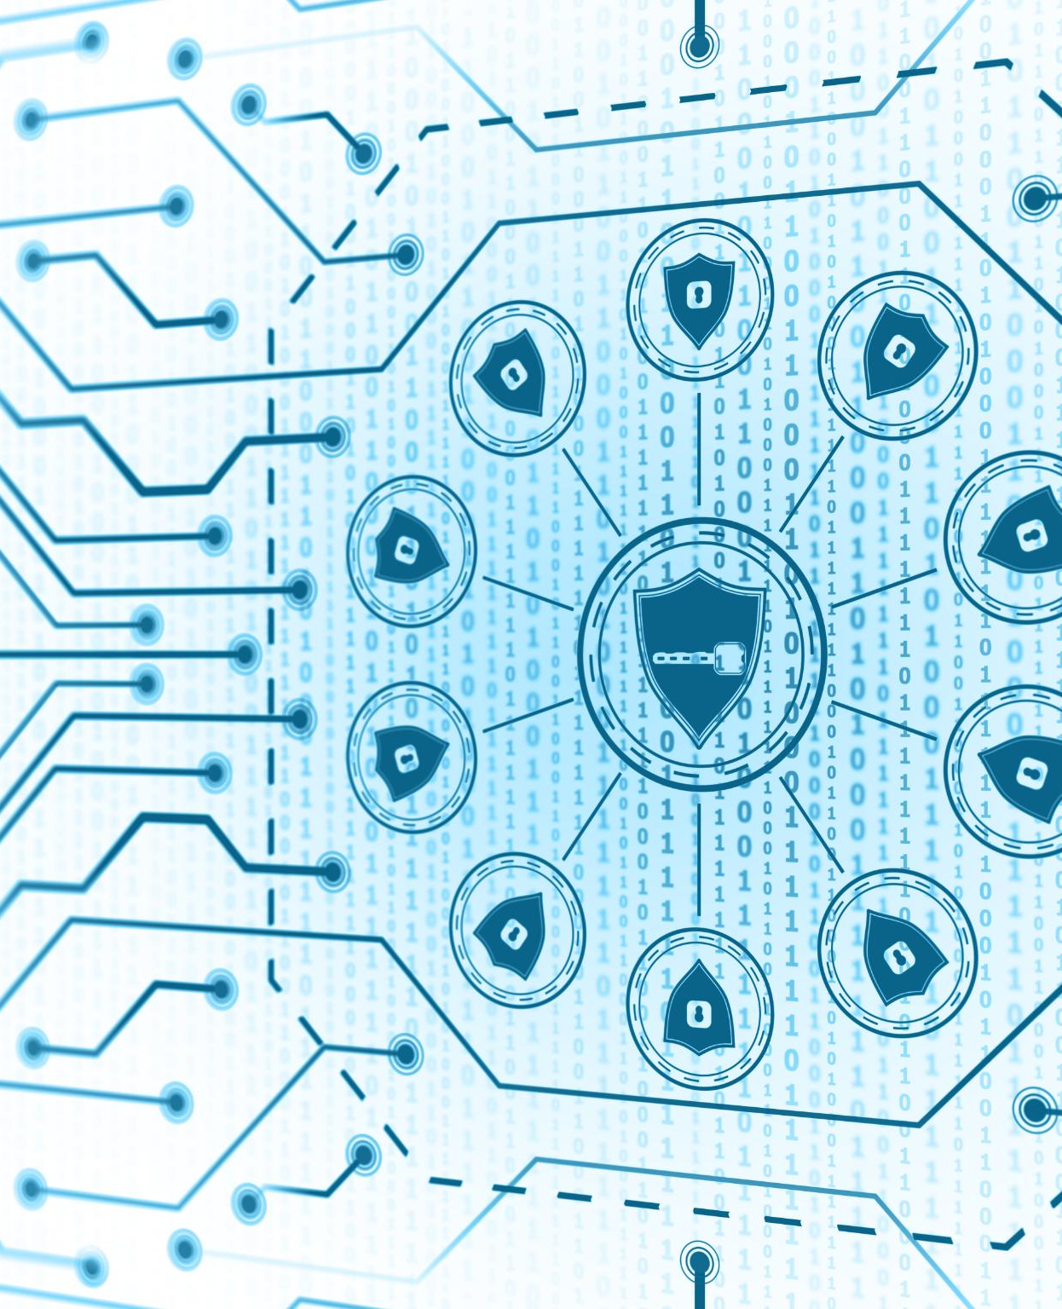
Topic Overview
Password Hygiene Importance
  Creating and managing strong passwords is essential to prevent unauthorized access and protect sensitive data.
Role of Multi-Factor Authentication
  MFA enhances security by requiring multiple verification methods like passwords combined with codes or biometrics.
Session Agenda Overview
  The session covers definitions, risks, consequences, and best practices to safeguard company assets effectively.
Notes:
Password Hygiene and Multi-Factor Authentication (MFA) are foundational elements of modern cybersecurity practices. Password hygiene refers to the disciplined approach of creating, managing, and protecting passwords to prevent unauthorized access. MFA adds an additional layer of security by requiring more than one verification method, such as a password combined with a code sent to a mobile device or biometric verification. This presentation will cover the definition of these concepts, their importance to Wayne Enterprise, real-world scenarios illustrating risks, consequences of poor practices, and actionable best practices. Employees will learn why strong passwords and MFA are critical, how attackers exploit weak credentials, and what steps they can take to safeguard sensitive data. The agenda includes: 1) Definition of Password Hygiene and MFA, 2) Why this matters to Wayne Enterprise, 3) Realistic risk scenarios, 4) Consequences of poor practices, and 5) Best practices and recommended mitigations. By the end of this session, employees will understand their role in protecting company assets and how to implement these security measures effectively.

Slide 3
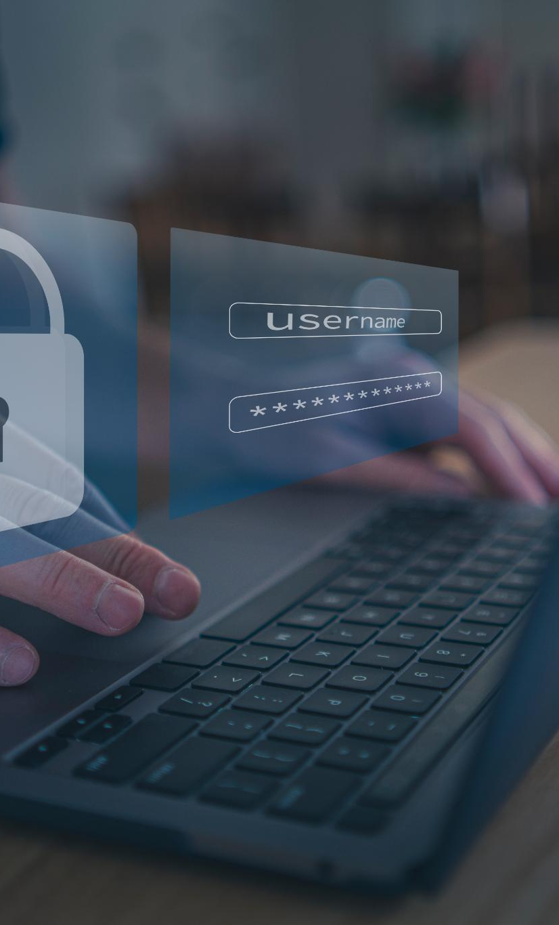
Why the Issue is a Risk to Wayne Enterprise
Vulnerabilities from Weak Authentication
  Weak passwords and lack of multi-factor authentication create risks for unauthorized access to sensitive data.
Common Attack Vectors
  Phishing, social engineering, and malware are frequent methods attackers use to steal credentials.
Consequences of Compromise
  A single compromised account can cause data breaches, intellectual property theft, and business disruptions.
Importance of Compliance and Shared Responsibility
  Regulatory compliance mandates strong authentication, and protecting credentials is a company-wide responsibility.
Notes:
Wayne Enterprise operates in a highly competitive and technology-driven environment, making it a prime target for cybercriminals. Weak passwords and lack of MFA create vulnerabilities that attackers can exploit to gain unauthorized access to sensitive systems and data. Credential theft through phishing emails, social engineering, and malware is one of the most common attack vectors. If employees reuse passwords or fail to enable MFA, the risk of compromise increases significantly. A single compromised account can lead to data breaches, intellectual property theft, and operational disruptions. Furthermore, regulatory compliance requirements mandate strong authentication practices, and failure to adhere can result in legal and financial penalties. Protecting credentials is not just an IT responsibility; it is a shared obligation across all departments. Understanding these risks helps employees appreciate why password hygiene and MFA are essential for safeguarding Wayne Enterprise’s reputation, financial stability, and customer trust.

Slide 4
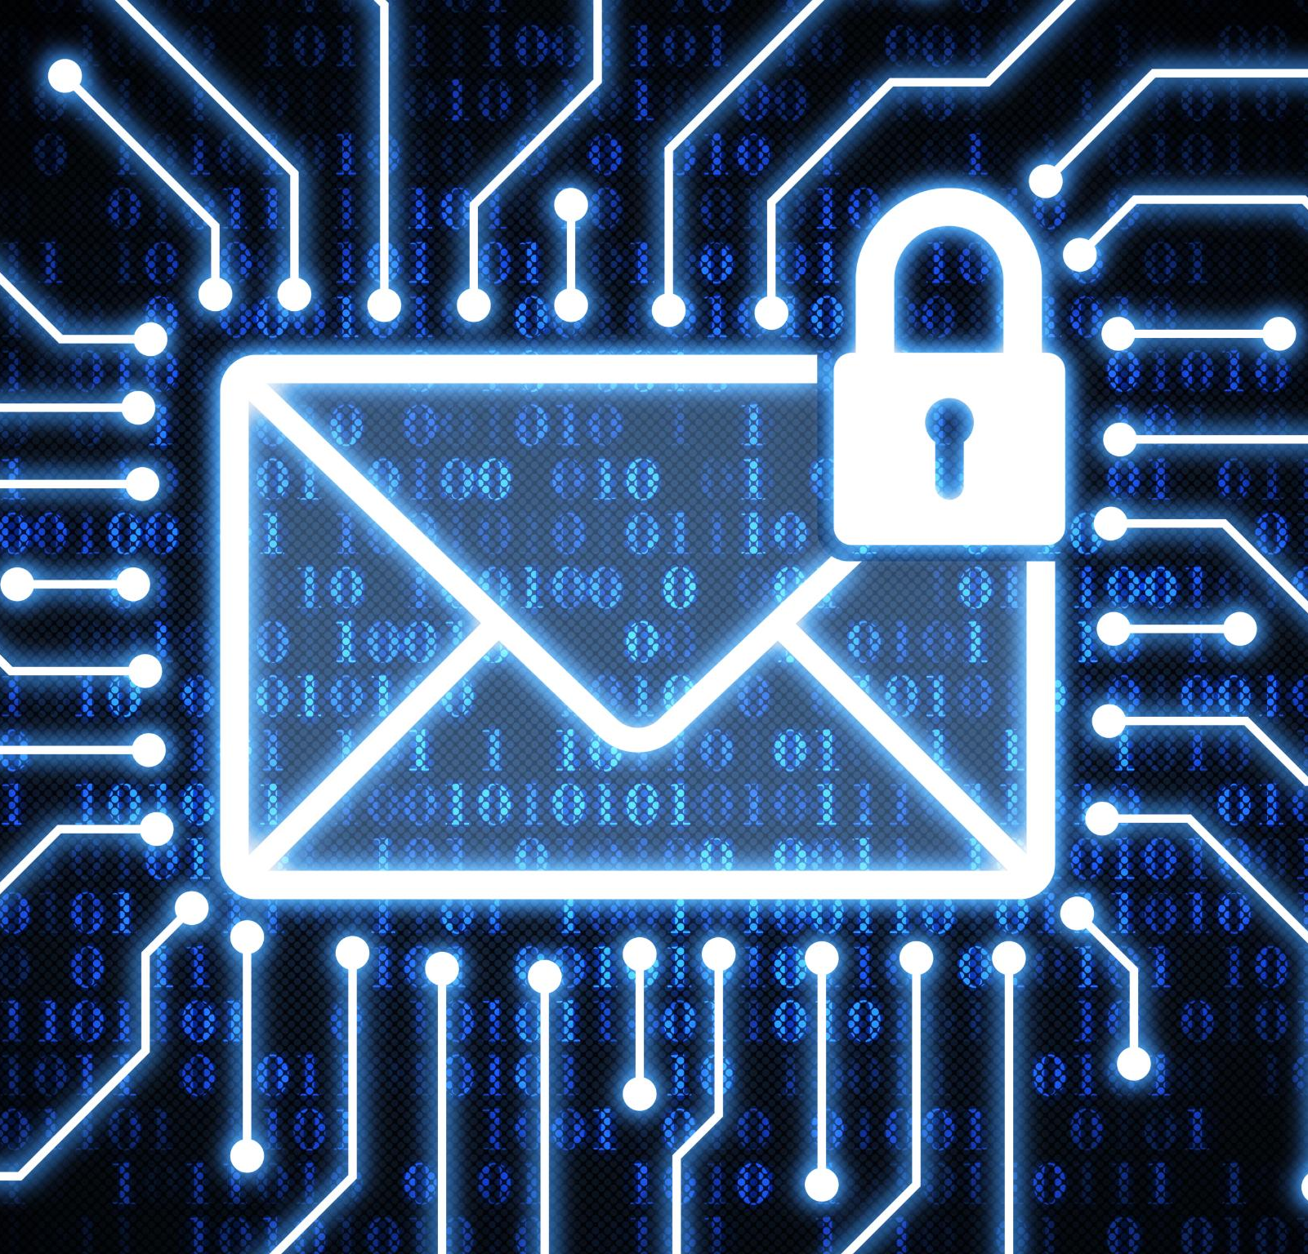
Realistic Examples of Scenarios
Phishing Email Threat
  Employees can be tricked by phishing emails disguised as legitimate IT requests to steal login credentials.
Shared Credentials Risk
  Storing shared credentials in unsecured spreadsheets exposes accounts to unauthorized access and breaches.
Unsafe Web Browsing
  Visiting malicious websites or drive-by downloads can lead to credential theft and data compromise.
Preventive Security Measures
  Verifying email authenticity, avoiding credential sharing, and enabling MFA help protect organizational data.
Notes:
Several realistic scenarios highlight the importance of proper password and MFA practices. For instance, an employee receives a phishing email disguised as an internal IT request, prompting them to enter their login credentials on a fake website. Another scenario involves shared credentials stored in unsecured spreadsheets, which are later accessed by unauthorized individuals. Unsafe web browsing can also lead to credential theft through malicious websites or drive-by downloads. These examples demonstrate how everyday actions can expose the organization to significant risks. Employees must recognize these threats and adopt preventive measures, such as verifying email authenticity, avoiding credential sharing, and enabling MFA on all accounts. By understanding these scenarios, employees can better identify suspicious activities and respond appropriately to protect company data.

Slide 5

Consequences of Failing to Follow Good Practices
Data Breach Risks
  Compromised credentials can expose sensitive data like customer info and intellectual property.
Reputational Damage
  Security incidents erode customer trust and investor confidence, damaging the company’s reputation.
Financial Losses
  Breaches led to fines, legal fees, and recovery costs, causing substantial financial impacts.
Operational Disruptions
  Ransomware or unauthorized access can halt business operations, reducing productivity and revenue.
Notes:
Neglecting password hygiene and MFA can lead to severe consequences for Wayne Enterprise. Data breaches resulting from compromised credentials can expose sensitive information, including customer data, financial records, and intellectual property. Such incidents often lead to reputational damage, eroding customer trust and investor confidence. Financial losses can be substantial, encompassing regulatory fines, legal fees, and recovery costs. Additionally, operational disruptions caused by ransomware or unauthorized access can halt business processes, impacting productivity and revenue. Employees must understand that their actions directly influence the organization’s security posture. A single weak password or failure to enable MFA can trigger a chain of events with long-lasting repercussions. Therefore, adherence to best practices is not optional but a critical responsibility for every team member.

Slide 6
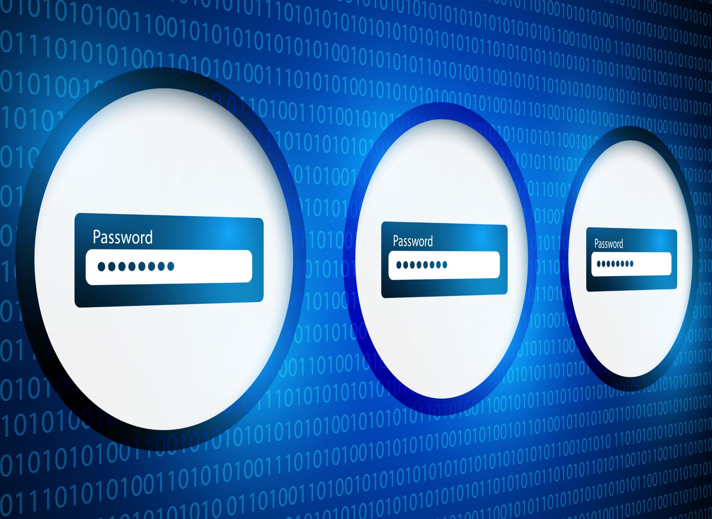
Best Practices and Recommended Mitigations
Create Strong Passwords
  Use unique passwords combining uppercase, lowercase, numbers, and special characters. Avoid personal and common words.
Enable Multi-Factor Authentication
  Activate MFA to add an additional security layer beyond passwords for better protection.
Use Password Managers
  Utilize trusted password managers to securely store credentials and avoid password reuse.
Stay Vigilant Against Phishing
  Verify email sources and avoid clicking unknown links to prevent phishing attacks.
Notes:
To mitigate risks, employees should follow these best practices: create strong, unique passwords for each account, combining uppercase and lowercase letters, numbers, and special characters. Avoid using personal information or common words. Enable MFA wherever possible to add an extra layer of security beyond passwords. Utilize a trusted password manager to securely store and manage credentials, reducing the temptation to reuse passwords. Never share passwords via email, chat, or unsecured documents. Regularly update passwords and monitor accounts for suspicious activity. Additionally, employees should remain vigilant against phishing attempts by verifying email sources and avoiding clicking on unknown links. Implementing these practices significantly reduces the likelihood of credential compromise and strengthens Wayne Enterprise’s overall security posture.

Slide 7

Key Takeaways
Strong Passwords & MFA
  Strong passwords combined with multi-factor authentication enhance security and protect sensitive company data.
Employee Cybersecurity Role
  Employees are crucial in cybersecurity by following best practices like avoiding password reuse and enabling MFA.
Use of Password Managers
  Password managers securely store and manage complex passwords, reducing the risk of breaches.
Phishing Awareness
  Remaining alert to phishing attempts helps prevent data breaches and protects organizational reputation.
Notes:
Strong passwords and MFA are essential components of cybersecurity. Employees play a critical role in protecting company data by adhering to best practices. Key points to remember include: never reuse passwords, always enable MFA, use password managers for secure storage, and remain alert to phishing attempts. By implementing these measures, employees help prevent data breaches, protect sensitive information, and maintain Wayne Enterprise’s reputation and compliance. Security is a shared responsibility, and every individual’s actions contribute to the organization’s resilience against cyber threats.

